Slide 1
Development Cost Charge (DCC) &
Capital Expenditure Charge (CEC)
Bylaw Review
Electoral Area Services Committee
May 21, 2026

Slide 2
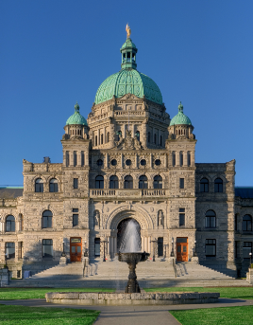
DCC & CEC Bylaw Review
Statutory Authority
Section 559 of the Local Government Act allows the RDOS Board to impose development cost charges (DCCs) in relation to new subdivision and construction.
DCCs can be used to assist in paying the capital costs of providing sewage and water related to the new development.

Slide 3
DCC & CEC Bylaw Review
Statutory Authority
Under Section 564 of the Act, a DCC bylaw must specify the amount of the charge(s) being imposed based on:
future land use & develop. patterns;
the phasing of works and services;
whether the charges are excessive; and
whether the charges will deter development.

Slide 4
DCC & CEC Bylaw Review
Statutory Authority
CEC bylaws are an authority reserved for the board of an improvement district (ID) under Section 698 of the Act.
Similar purpose as DCCs; to implement charges on new development to assist with capital costs incurred by an ID.
The RDOS has inherited a number of CEC Bylaws as result of taking over IDs.

Slide 5
DCC & CEC Bylaw Review
Background:
Naramata Irrigation District CEC (Water) Bylaw No. 443, 1994;
Naramata Water System DCC Bylaw No. 1804, 1997;
Faulder Community Water System DCC Bylaw No. 1894, 1998;
Olalla Improvement District Mobile Home CEC Bylaw No. 24, 1976;
Olalla Improvement District CEC Bylaw No. 32, 1976;
Okanagan Falls Sanitary Sewer DCC Bylaw No. 2486, 2009;
Okanagan Falls Irrigation District CEC Water Bylaw No. 371, 2012;
Sun Valley Irrigation District CEC Subdivision Bylaw No. 14, 1988; and
West Bench Irrigation District CEC Subdivision Bylaw No. 101, 1991.

Slide 6
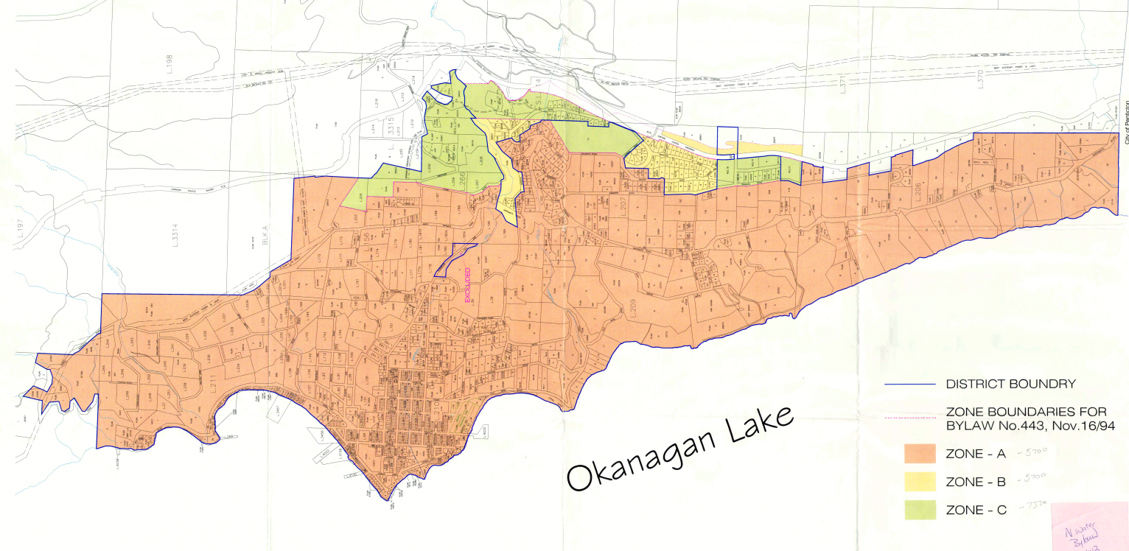
DCC & CEC Bylaw Review
DCC Bylaw

Slide 7
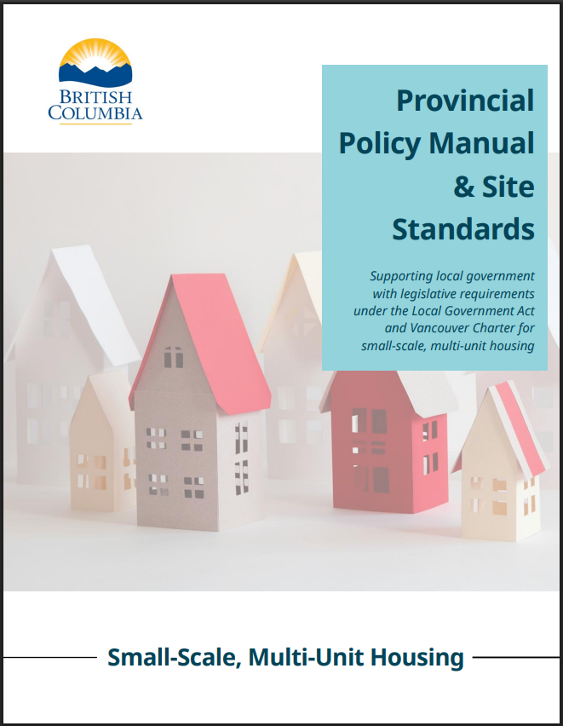
DCC & CEC Bylaw Review
Background:
Provincial Local Government Housing Initiatives (LGHI) Funding provided $232,650 to the Regional District.
On January 9, 2025, the Board resolved that approximately $216,667 of the grant funding be allocated to the Development Cost Charge (DCC) Bylaw Review.

Slide 8
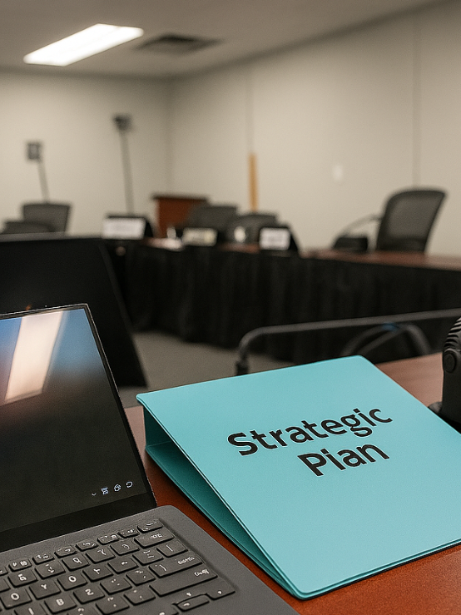
DCC & CEC Bylaw Review
Issues:
A majority of RDOS DCC & CEC Bylaws are over 20-years of age;
Considered good practice to review DCC Bylaws every 5-years;
Provincial funding created a one-time increase in demand for a relatively small pool of specialized consulting firms who specialize in DCC reviews.

Slide 9
DCC & CEC Bylaw Review
Issues:
DCC Bylaw has been delayed (originally anticipated being completed in 2025);
Significant inflationary period since 2020 (e.g. Osoyoos rates are increasing 196%-385%);
Incorporation of Okanagan Falls is likely to occur prior to the completion of the DCC review.

Slide 10
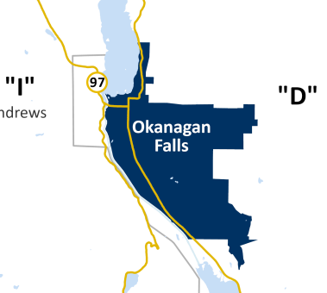
DCC & CEC Bylaw Review
Issues:
Current project would only be reviewing water and sewer charges in Okanagan Falls.
The new District Municipality may wish to expand this to address new areas of responsibility, including storm water drainage, roads and parks.

Slide 11

DCC & CEC Bylaw Review
Issues:
Proposed to remove Naramata as a “Rural Growth Area” under the RGS Bylaw.
Identified upgrades to the water system are seen to be unrelated to “growth”.
In the absence of a community sewer system, future growth will be limited.
Charges other than DCCs may be more appropriate to support the water system.

Slide 12

DCC & CEC Bylaw Review
Proposal:
That all DCC & CEC bylaws, with the exception of Okanagan Falls, be repealed;
That the LGHI funding be re-assigned to a modelling of the Naramata Water System;
That remaining DCC/CEC funds be spent over-time in support of the applicable water system.

Slide 13
DCC & CEC Bylaw Review
Recommendation:
THAT the Development Cost Charge Bylaw and Capital Expenditure Cost Bylaw Repeal Bylaw No. 3113, and Okanagan Falls Sanitary Sewer Development Cost Charge Amendment Bylaw No. 2486.03 be initiated;
AND THAT the EA Services Committee supports the remaining Local Government Housing Initiatives (LGHI) Funding of $216,667.00 be allocated to a capacity modelling/analysis of the Naramata Water System;
AND THAT the EA Services Committee supports the funds be directed to the Naramata Water System - 2026 Phase of Capital and Master Plan Model Update project already on the 2026 Strategic Priorities List;
AND THAT the EA Services Committee directs staff to prepare a budget amendment reflecting the reallocation of LGHI Funding for consideration by the Board.

Slide 14
DCC & CEC Bylaw Review
Alternatives:
Status quo;
THAT Development Cost Charge (DCC) Bylaw Update be abandoned and removed from the 2026 Strategic Priorities List (Item No. 24.160.2);
AND THAT the remaining Local Government Housing Initiatives (LGHI) Funding of $216,667.00 be allocated to a capacity modelling/analysis of the Naramata Water System;
AND THAT the funds be directed to the Naramata Water System - 2026 Phase of Capital and Master Plan Model Update project already on the 2026 Strategic Priorities List.

Slide 15
DCC & CEC Bylaw Review
Questions?

